Slide 1

Machine Learning I:
Preliminaries, Feature Selection & Feature Engineering
Patrick Hall
Visiting Faculty, Department of Decision Sciences
George Washington University

Slide 2
Lecture 1 Agenda
Preliminaries
Feature Engineering for Data Quality
Feature Engineering Strategies
Readings

Slide 3
Preliminaries
Syllabus
Basic data manipulation
Primer on technical malpractice
Whiteboard notation
What is feature engineering?
Creating new features (columns/features) from the originally available data or from auxiliary data sources.
Why do we engineer features?
To address data quality problems, i.e. “data cleaning.”
To change the representation of data in ways that are thought to improve learning.

Slide 4
Where are we in the modeling lifecycle?
Supervised Learning
Data Collection & ETL
Feature Selection & Engineering
Assessment & Validation
Deployment
Unsupervised Learning
Cost Intensive
Revenue
Generating

Slide 5
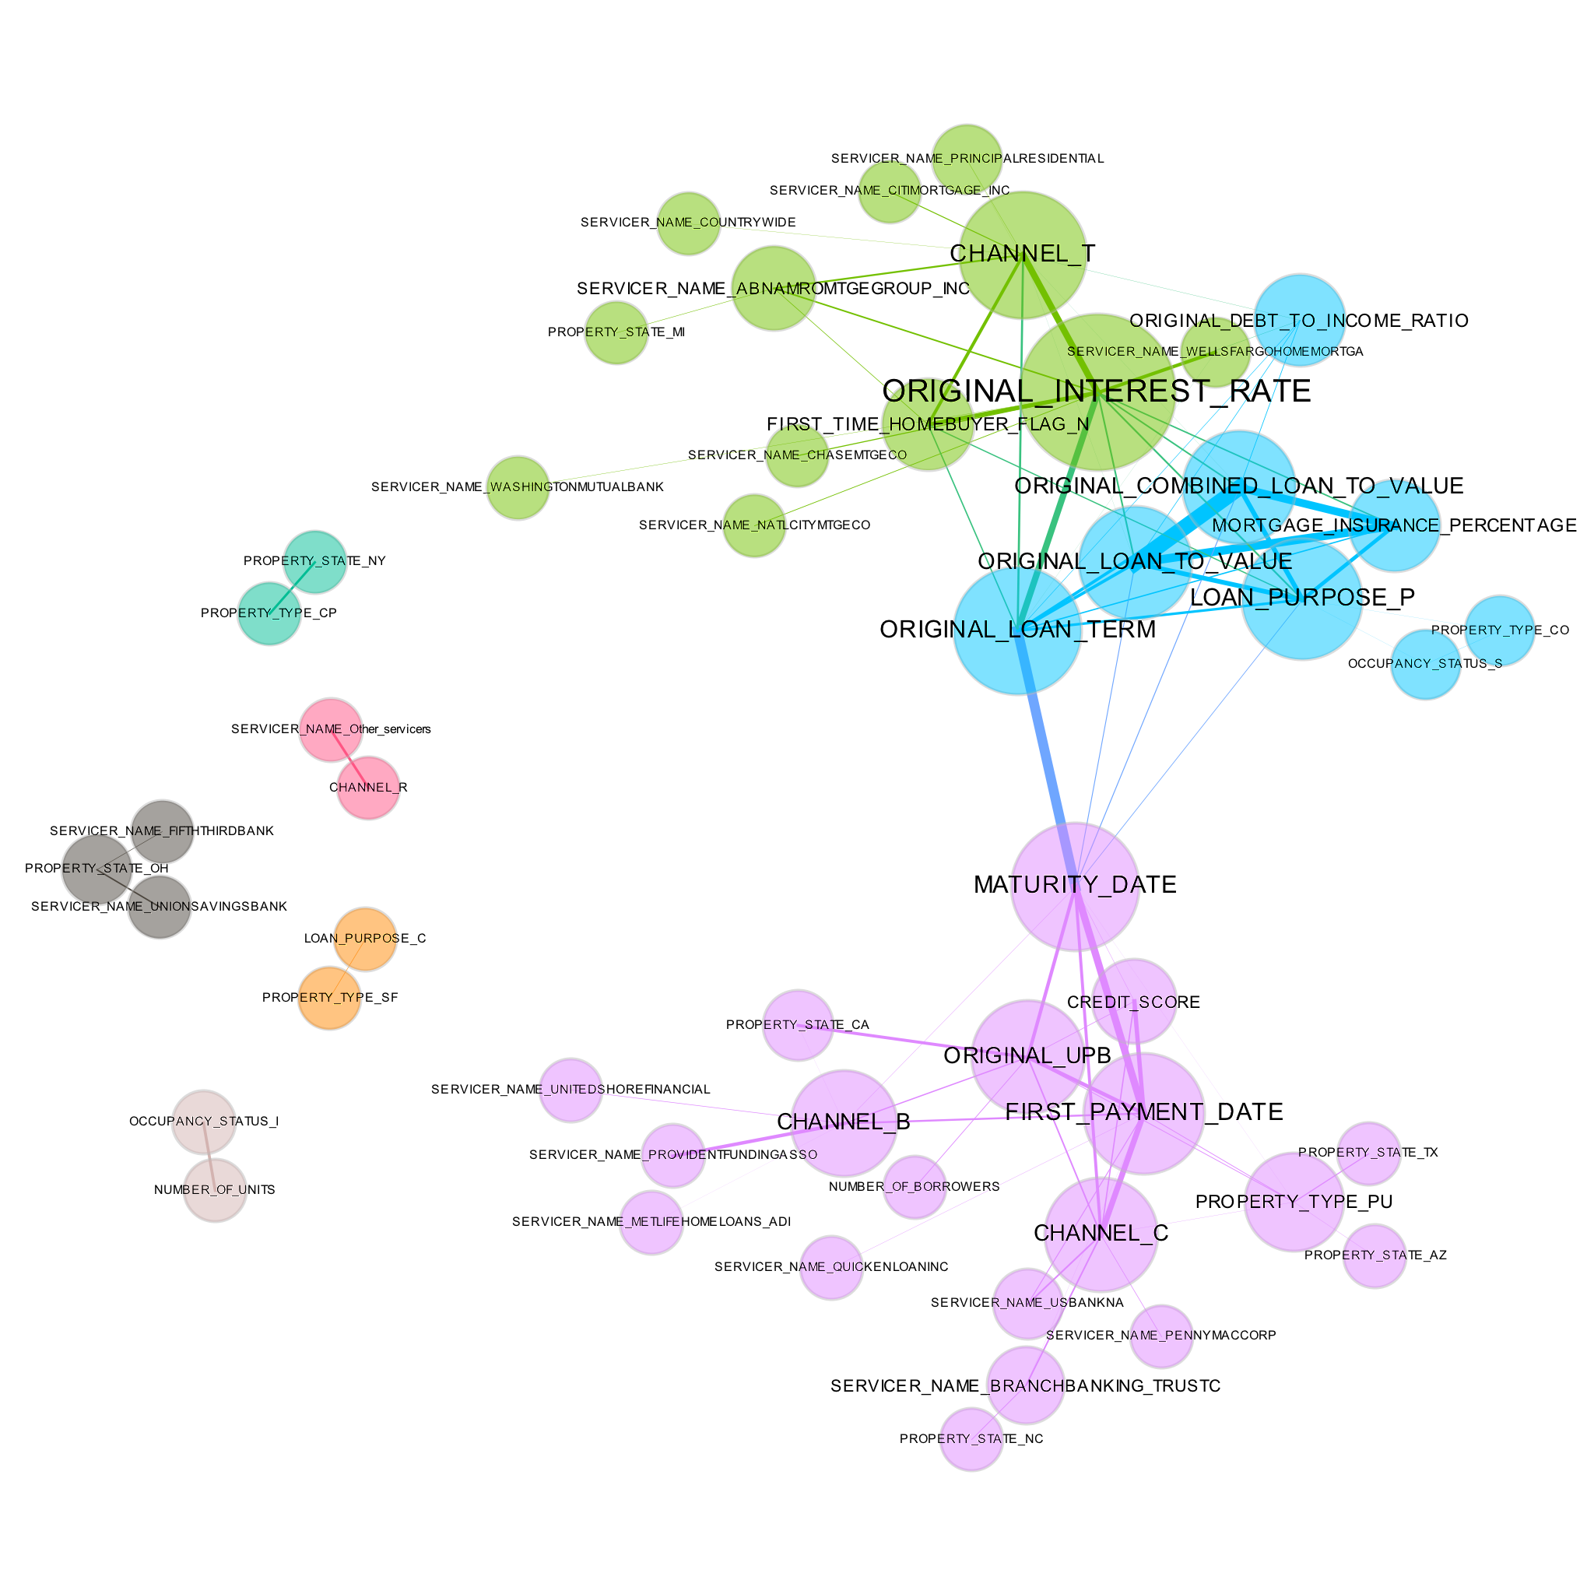
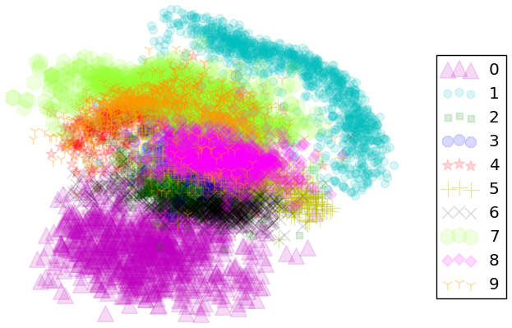
Reminder: Know Thy Data
Source: https://github.com/jphall663/hc_ml/blob/master/main.pdf
Notes:
Descriptive statistics, correlation heatmaps work well too

Slide 6
Feature Engineering for
Data Quality Problems

Slide 7
Common Data Quality Problems
Poor data quality negatively affects many data processing efforts!
Data quality must be addresses for reliable modeling outcomes
Types of common data quality problems:
Imbalanced data
Data with disparate scales
Non-normalized data
Duplicate data
Noise and outliers
Missing values
Character data
High-cardinality data
Correlated data
Wide data
Sparse data
Incomplete data
Biased data
Fake data
Wrong and dirty data

Slide 8
Imbalanced Data: Inputs & Targets
Imbalanced Input - only presence of a non-zero attribute value is regarded as important
Words present in documents or items present in customer transactions (credit card defaults)
Imbalance Target
Symptoms
Single class model predictions
Biased model predictions
Solutions
Proportional Sampling
Taking all the rows containing rare events in a data set and increasing them proportionally to the number of rows not containing rare values
Both oversampling and undersampling artificially inflate the frequency of rare events, which helps models learn to predict rare events, but makes interpreting results more difficult
Inverse prior probability weighting
Mixture models: e.g. zero-inflated regression methods
Adapted from: Introduction to Data Mining

Slide 9
Disparate Scales
Symptoms
Biased models and inaccurate results
Unstable parameter estimates
Solutions
Standardization
Enforcing similar scales on a set of features
For distance-based algorithms (e.g. k-means) and algorithms that use gradient-related methods (e.g. regression, artificial neural networks), to create model parameters features must be on the same scale
Otherwise features with large values will incorrectly dominate the training process
Appropriate algorithm selection: Tree-based models

Slide 10
Non-normalized & Duplicate Data
Non-normalized data:
Most ML algorithms are not smart enough to know the difference between:
DC, D.C., #dc, District of Columbia, etc.
Duplicate data:
Are these the same customer?!
Patrick Hall
jpatrickhall@gmail.com
1414 M St.
Washington, DC, 20005
Johnston Hall
jphall@gwu.edu
1414 M St.
Washington, DC, 20005
If we want these entities to be treated as the same thing by an ML algorithm, which we usually do, it takes manual coding efforts or expensive data quality software.

Slide 11
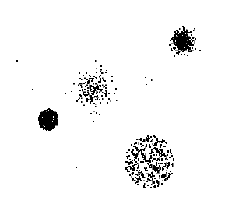
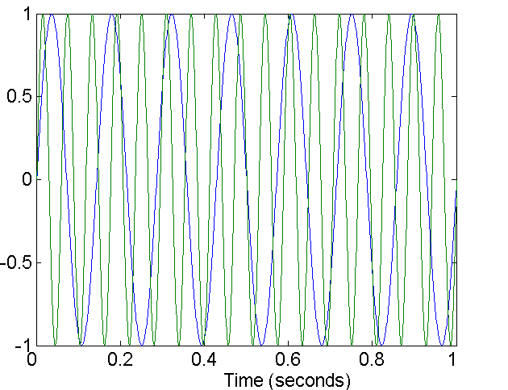
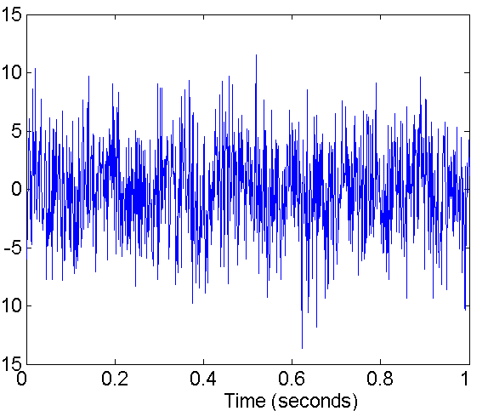
Noise & Outliers
Noise are rows with the same input values, but different target values.
Outliers are rows with characteristics that are considerably different than most of the other rows in the data set
Noise interferes with data analysis
Goal of our analysis – are we finding fraud?
Outliers (?)
Two Sine Waves
Two Sine Waves + Noise
Source: Introduction to Data Mining

Slide 12
Outliers
Symptoms
Biased models and inaccurate results
Unstable parameter estimates and rule generation
Unreliable out-of-domain predictions
Solutions
Appropriate algorithm selections: e.g. Huber loss functions
Discretization
Changing a numeric feature into an ordinal or nominal categorical feature based on value ranges of the original numeric feature, also referred to as “binning”
Discretization has many benefits:
Commonly used in linear models to increase flexibility and helps introduce nonlinearity
Smoothes complex signals in training data, often decreasing overfitting
Deals with missing values or outliers elegantly by assigning them to their own bin
Winsorizing
Removing outliers in a feature's value and replacing them with more central values of that feature

Slide 13
Missing Values: Uncollected Information
Symptoms
Information loss
Biased model and inaccurate results
Solutions
Imputation
Replacing missing data with an appropriate, non-missing value
In predictive modeling, imputing should be used with care:
Missingness is often predictive
Imputation changes the distribution of the input feature learned by the model
Discretization
Appropriate algorithm selection
Tree-based models
Naïve Bayes classification
Adapted from: Introduction to Data Mining

Slide 14
Character Features: Encoding
Symptoms - information loss, computational errors, and biased models and inaccurate results*
Encoding
Changing the representation of a feature. Very often in data mining applications categorical, character features are encoded to numeric features to be used with algorithms that cannot accept character or categorical features.
Target Encoding (Categorical)
An encoding method for changing categorical features into numeric features when the target is a categorical feature. Particularly helpful when a categorical feature has many levels.
Target Encoding (Numeric)
An encoding method for changing categorical features into numeric features when the target is a numeric feature. Particularly helpful when a categorical feature has many levels
Appropriate algorithm selection
Tree-based models
Naïve Bayes classification
* In some cases this is not a problem at all. Some algorithms and software packages handle this automatically and elegantly … some don't.

Slide 15
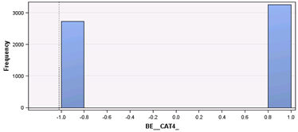
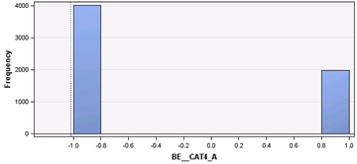
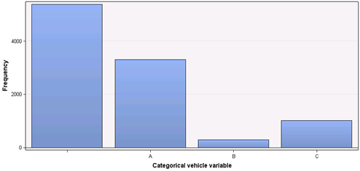
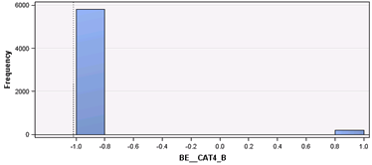
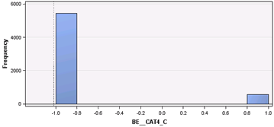
Illustration: Encoding
Encoding
Interval Binary (1, -1) Indicator for Missing
Interval Binary (1, -1) Indicator for A
Original categorical input: Cat4
Four nominal levels: Missing, A, B, and C
Interval Binary (1, -1) Indicator for B
Interval Binary (1, -1) Indicator for C
Source: 2015 SAS Global Forum Proceedings

Slide 16
High Cardinality Categorical Features
Symptoms
Over-fit models and inaccurate results
Long and intolerable compute times
Unreliable out-of-domain predictions
Solutions
Target encoding (categorical) or variant
Perturbed rate-by-level, smoothing or weight of evidence
Target encoding (numeric) or variants average-, median-, BLUP-by-level
Discretization
Embedding approaches
Entity embedding neural networks, factorization machines

Slide 17
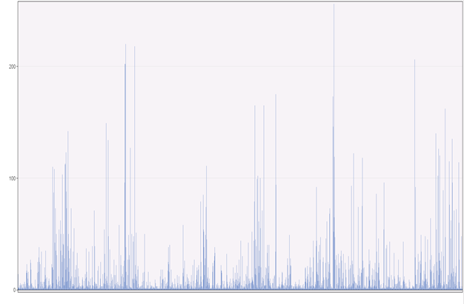
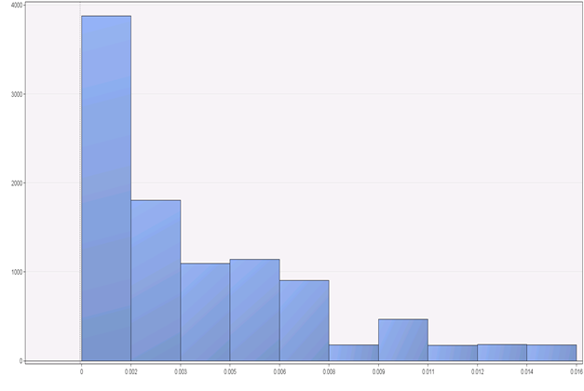
High-Cardinality Inputs
Bin Rare Levels Transform to Interval
Transform to interval
Frequency
Frequency
Blind_submodel
Blind_submodel_interval
Source: 2015 SAS Global Forum Proceedings
Notes:
Rare levels and too many levels can cause over fitting
weight of evidence: WoE = log(goods/bads)*100
Leave-one-out odds: (frequency of 1 for all other occurrences of current level)/(total number of all levels – 1)

Slide 18
Strong Multicollinearity: Correlated Data
Symptoms
Unstable parameter estimates
Unstable rule generation
Unstable predictions
Solutions
Feature selection
Feature extraction
L2 Regularization

Slide 19
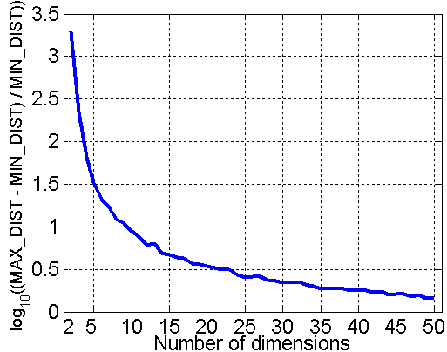
Wide Data: Curse of Dimensionality
When dimensionality increases, data becomes increasingly sparse in the space that it occupies.
Definition of density and distance between points becomes less meaningful
Error estimates, outlier detection and clustering
Symptoms
Long and intolerable compute times
Meaningless results due to curse of dimensionality
Solutions
Feature selection
Feature extraction
L1 Regularization
Dimensionality Reduction
Avoid curse of dimensionality
Allow data to be more easily visualized
May help to eliminate irrelevant features or reduce noise
Randomly generate 500 points
Compute difference between max and min distance between any pair of points
Source: Introduction to Data Mining
Adapted from: Introduction to Data Mining

Slide 20
Wide Data: Feature Selection
Finding the best subset of original features from a data set, typically by measuring the original feature's relationship to the target feature and taking the subset of original features with the strongest relationships with the target.
Decreases the impact of the curse of dimensionality and usually increases the signal-to-noise ratio in a data set, resulting in faster training times and more accurate models.
Because feature selection uses original features from a data set, its results are usually more interpretable than feature extraction techniques.

Slide 21
Wide Data: Feature Extraction
Create new attributes that can capture the important information in a data set more efficiently than the original attributes.
Feature extraction, construction, mapping data to new space.
Combining the original features in a data set into a new, smaller set of more representative features, very often using unsupervised learning methods.
Feature extraction may also be referred to as “dimension reduction.”
Feature extraction is the unsupervised analog of feature selection, i.e. it tends to decreases the impact of the curse of dimensionality and usually increases the signal-to-noise ratio in a data set.
Feature extraction techniques combine the original features in the data set in complex ways, usually creating uninterpretable new features.

Slide 22
Sparse Data*
Symptoms
Long, intolerable compute times
Meaningless results due to curse of dimensionality
Solutions
Feature extraction
Appropriate data representation
i.e. COO, CSR
Appropriate algorithm selection
e.g. factorization machines
* In some cases this is not a problem at all. Some algorithms and software packages handle this automatically and elegantly … some don't.

Slide 23
Incomplete Data
When a data set simply does not contain information about the phenomenon of interest, there is no analytical remedy for incomplete data
Symptoms
Useless models and meaningless results
Solutions
Collect more and better data
Maybe dispose of the original incomplete set
Design of Experiment approaches

Slide 24
Biased Data
When a data set contains information about the phenomenon of interest, but that information is consistently and systematically wrong
There is no real analytical remedy for biased data
Symptoms
Based models and biased, inaccurate results
Solutions
Must collect more and better data
Maybe dispose of the original biased set
Design of Experiment approaches
Data simulation?
Re-weighing or bias-aware models (e.g., adversarial de-biasing)?

Slide 25
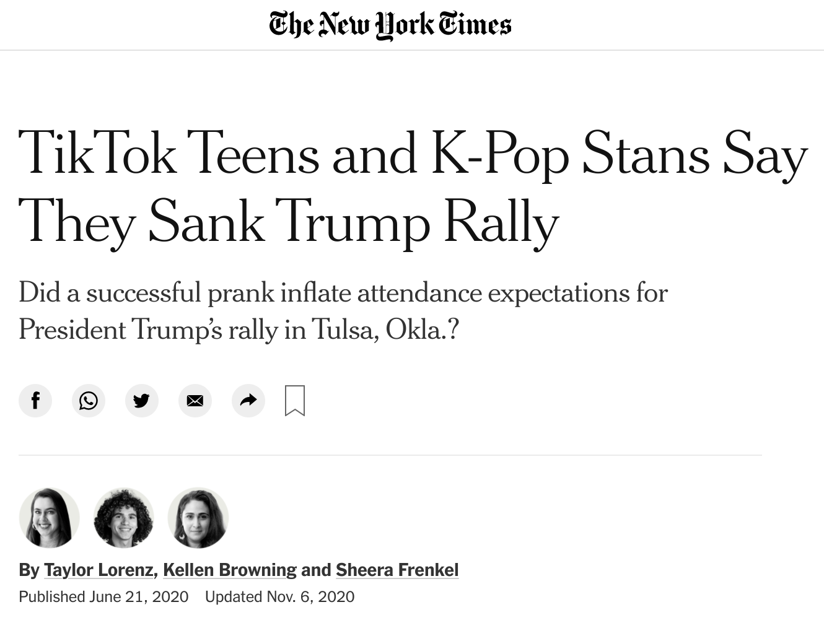

Fake Data: Recent Headlines
Source: https://www.nytimes.com/2020/06/21/style/tiktok-trump-rally-tulsa.html.
Source: https://thispersondoesnotexist.com/.

Slide 26
Wrong & Dirty Data
Most real-world data is wrong and dirty. And if you’re data is wrong and biased, your ML models will be wrong and biased too!
Symptoms
Information loss
Biased models and inaccurate results
Long, intolerable compute times
Unstable parameter estimates
Unstable rule generation
Unreliable out-of-domain predictions
Solutions
Hard work and using our brains
Combination of solution strategies in slides above

Slide 27
Feature Engineering Strategies

Slide 28
Feature Engineering Strategies
There are known strategies and techniques for feature engineering. Consider them first before getting creative on your own:
Casual Discovery
Discretization
Distributional stability: select features whose distributions are stable over time
Ensemble feature selection: use ensemble feature importance when few features of many are important
Interactions: plus, minus, multiply, divide, higher order interactions
Past behavior and domain expertise
Sparse feature extraction: use feature extraction when many features are important; sparse techniques preserve interpretability
Time-series: autoregressive (AR) terms/lags and moving averages (MA, EWMA)
Transaction Summarization:
Label, Segment, Featurize
Aggregating: mean, min., max., median, etc.

Slide 29
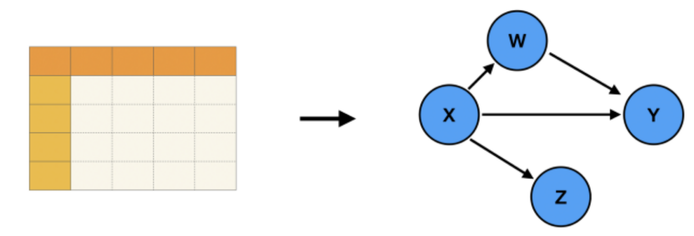
Causal Discovery
If model inputs are causal to model outputs, models should be more stable, accurate, and fair.
There are tricks and prescribed methods for finding features that are causal to other features.
Some tricks:
Two features that are statistically independent (x ⊥ y) do not have a causal relationship.
Two features (x, y) that are not statistically independent, e.g., y = g(x) + e, are in a casual relationship (x → y) when x is independent of e (x ⊥ e).
Some methods:
Spirtes and Glymour algorithm (PC algorithm)
Non-linear additive noise model (NANM)
Linear non-Gaussian acyclic model (LiNGAM)
Some are very slow!!
w
x
y
z
Adapted from: https://towardsdatascience.com/causal-discovery-6858f9af6dcb.

Slide 30
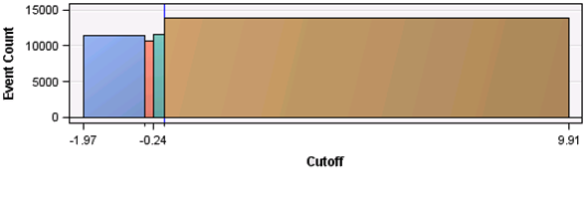
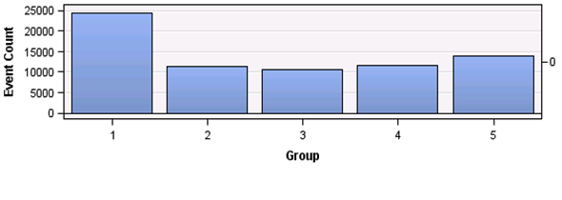
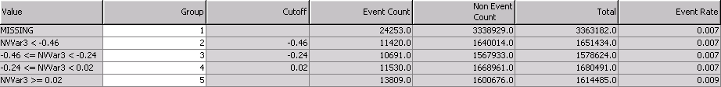
Discretization
Distribution wrt Target Event
Optimal
Binning
Binned Distribution wrt Target Event
Binned Frequency Table
Enables incorporation of missing values
Decreases impact of outliers during training
Accounts for outliers during scoring
Generates more parameters for better fitting of nonlinear phenomena
Optimal bins can increase the accuracy of many types of predictive models
Less effective for decision trees
Source: 2015 SAS Global Forum Proceedings
Notes:
Optimal bins are like “pre-modeling” – they spoon feed information to the model.
Computers always bin – your info is always represented as a certain number of bytes; and even models like decision trees always bin; optimal binning allows you to increase the resolution of your info where it’s relationship with the target feature is most well defined; you are using your bits more efficiently and increasing the signal-to-noise ratio.

Slide 31
Label, Segment, Featurize
A systemic approach to converting transactional data into training data.
cust_ID | timestamp | event
5678u8k | 6:17 | browse
5678u8k | 7:02 | purchase
5678u8k | 9:21 | browse
5678u8k | 11:45 | purchase
5678u8k | 13:01 | browse
5678u8k | 13:39 | browse
5678u8k | 15:50 | purchase
5678u8k | 18:22 | browse
cust_ID | first_browse_t | n_browse | purchase
5678u8k | 6:17 | 1 | 0
5678u8k | 13:01 | 2 | 1
L-S-F
t_{c} = 3 hours
labeling window = 1 event
lag = 2
lead = 0
non-overlapping events
Adapted from: Label, Segment, Featurize, Figure 3.
Notes:
Use when few vars are important
Ensembles – feature hiding, better prepared to make a decision about phenomenon that seemed rare in test data

Slide 32
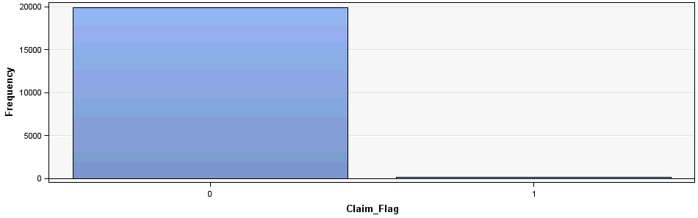
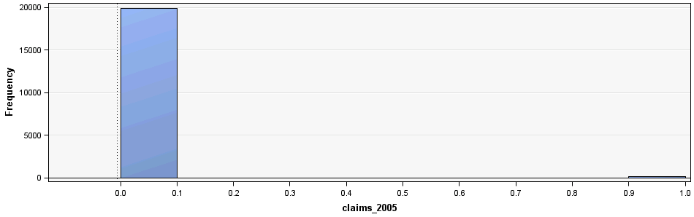
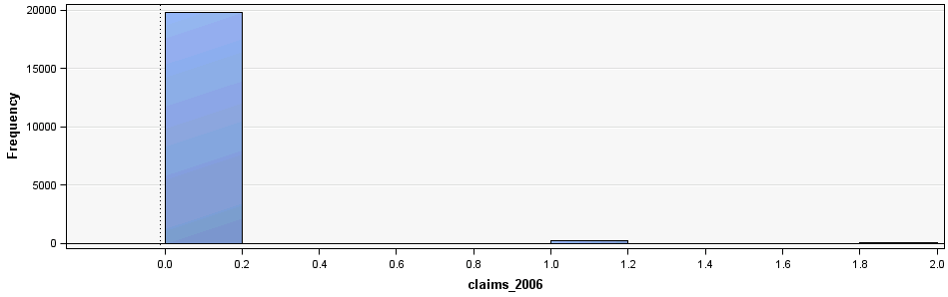
Past Behavior: Correlate claims in 2007 with claims in 2005 and 2006
r = 0.37662
r = 0.44168
Source: 2015 SAS Global Forum Proceedings

Slide 33
Additional Feature Engineering Techniques
Best linear unbiased predictors (BLUPs)
Clusters
Distance from cluster centroids
Date expansion
Feature encoding:
Bayesian smoothing
Cross-validated encoding
Cluster encoding
Encoding one feature with another’s values, or discretized features
Leave-one-out encoding
Frequency
Holidays
Lexigraphical sorting indices
Linear model predictions
One-hot encoding
Target sorting indices
Stacked predictions
Weight of evidence
Source: https://docs.h2o.ai/driverless-ai/1-10-lts/docs/userguide/transformations.html

Slide 34
Reading
Label, Segment, Featurize: a cross domain framework for prediction engineering
Introduction to Data Mining - Sections 2.2-2.3 (Chapter 2 notes)
Introduction to the Foundations of Causal Discovery - Sections 1-3

